Slide 1

Vidya Prathisthans Kamalnayan Bajaj Institute of engineering And Technology Department of Electronics and telecommunication
SMART ELECTRIC BOARD
Student Name :
Name : Rutik andhalkar ,roll no :21320001
Name : tushar burte ,roll no :21320016
Name : aavesh bagwan ,roll no :21320007 mentor : Dr.S.b. lande sir

Slide 2
Content
Introduction
Abstract
Objective and Application
Tools and technology
Methodology
Circuit diagram and working
Simulation
Conclusion
References

Slide 3
Introduction
In this presentation we are going to present you about the project smart electric board.
Which is based on the IOT home automation concept .
This project demonstrate the home automation in practical and efficient manner .
This project uses NodeMCU esp8266 and Blynk cloud platform to control electrical appliances Using our smart phone over the internet from any part of the world.

Slide 4
Abstract
Automation can be accomplished by using the Internet of Things (IOT). This gives the inhabitant accesses to certain data in the house and the ability to control some parameters remotely.
This presentation presents the complete design of an IOT based controlling system for smart home automation.
The proposed design uses blynk IOT cloud platform for collecting and visualizing monitored data and remote controlling of home appliances and devices.
The selected platform is very flexible and user-friendly. The sensing of different variables inside the house is conducted using the NodeMCU-ESP8266 microcontroller board.

Slide 5
Objective and Application
As home automation getting more and more popularity due to its ease of use and due to making human life more comfortable , therefore this project will allow us to move in that direction.
This will help physically disabled people to control home appliances in critical situations.
As we know that lot of people forget to turn of home electrical appliance because of that lot of electricity gets wasted and by using this we can save that electricity as well because we can control it from anywhere in the world.

Slide 6
Tools and Technologies
NodeMCU ESP8266 Microcontroller
Relay Module
Blynk Cloud Platform
Arduino IDE

Slide 7
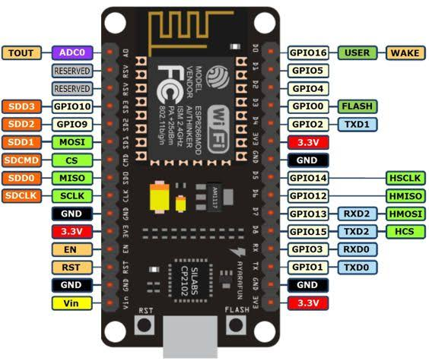
NodeMCU ESP8266
The ESP8266 is a very user-friendly and low-cost device to provide internet connectivity to your projects. The module can work both as an Access point (can create hotspot) and as a station (can connect to Wi-Fi).
Specifications
Digital I/O pins : 16
Analog Input pins : 1
Microcontroller : Tensilica 32 bit RISC CPU Xtensa LX106
Input voltage : 7-12 V
Operating voltage : 3.3 V
Clock Speed : 80MHz
2.4 GHz receiver antenna
PWM , UART , SPI , I2C pins

Slide 8
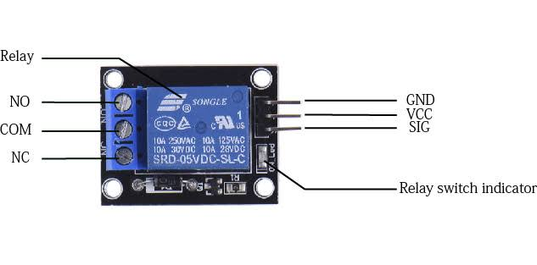
Relay Module
Relay is electrically operated switch it is used to control signal at the output by signal at the input.
It has one VCC pin at the input side and one GND pin at the input side and one input pin as well.
At the output side it has NO(normally open), NC(normally closed) and COM(common) pin.

Slide 9

Blynk Cloud Platform
Blynk is a full suite of software (cloud platform) required to prototype, deploy, and remotely manage connected electronic devices at any scale: from personal IoT projects to millions of commercial connected products.
With Blynk anyone can connect their hardware to the cloud and build a no-code iOS, Android, and web applications to analyze real-time and historical data coming from devices, control them remotely from anywhere in the world, receive important notifications and much more.

Slide 10
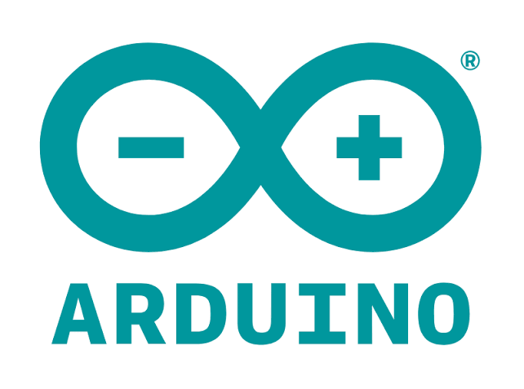
Arduino IDE
Arduino Integrated Development Environment (IDE) is an open source platform used to writing and compiling code for controlling microcontrollers and uploading code to the microcontrollers as well.

Slide 11
Methodology
First of all we download the Arduino IDE and configure it for the board NodeMCU esp8266 by downloading its library and Blynk cloud platform by downloading its library.
Then we open an account on blynk cloud platform and create template in it where as template includes information about which board we want to connect to the blynk and also contains template id and device name which is used while programming the board.
Then inside that template we create Datastream which uses virtual pin which carries data from NodeMCU board to the blynk and vice versa.
Then we configure web dashboard for interacting user with the board via blynk cloud.
Then we need to create mobile dashboard as well by installing blynk app on smartphone.
Then we make connection NodeMCU with the relay module according to the circuit diagram
Then we write code for the project and upload that code into the microcontroller using Arduino IDE and we connect NodeMCU to the Blynk by using there library, template id and device name and we also connect NodeMCU to the internet using blynk app .

Slide 12
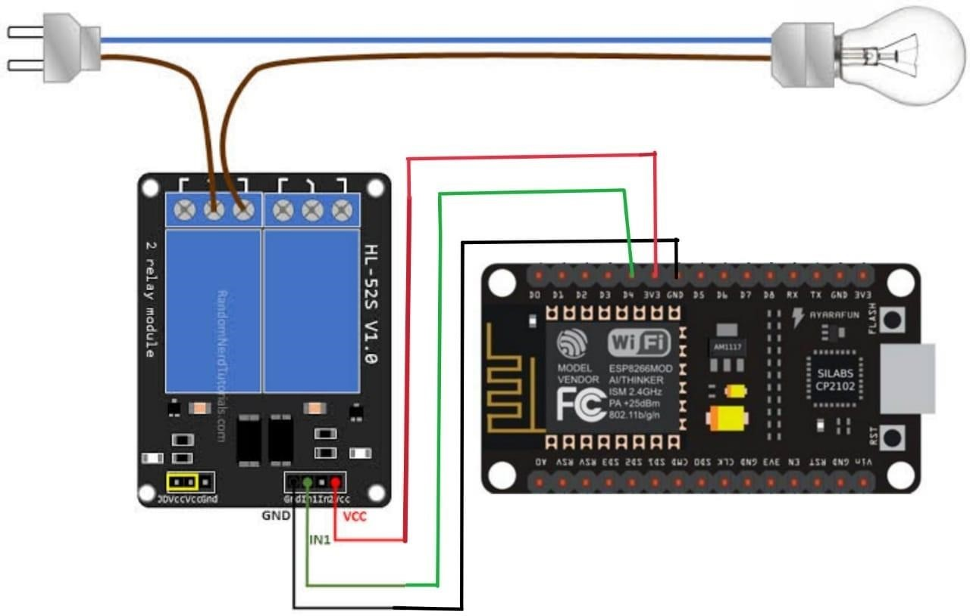
Circuit Diagram
D4 pin is connected to the IN pin of relay
Ground pin of the nodemcuESP8266 is connected to the ground pin of the relay
Another 3v3 pin is connected to the Vcc pin of the relay and the electrical equipment is connected between com pin and NO pin of the relay.

Slide 13
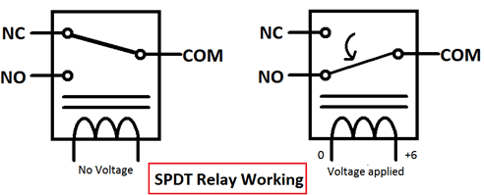
Working
Relay is electrically operated Switch it is controlled by IN pin at the input side when current flows through it , it changes configuration at the output side
There three pins at the output NC, NO, COM, where as COM pin in by default connected to the NC pin and disconnected from NO pin
But when current flows throw IN pin COM changes its position from NC to NO and further also it changes its position from one to other depending on the input at IN pin.
And we connect one end of the wire to the COM and other at the NO because we want normally open configuration(i.e. default close switch).
The relay we are using is an electromagnetic relay.

Slide 14
Working
And the input at the IN pin is controlled by the NodeMCU ESP8266 it is connected to the digital pin d4 whose value can be either high or low.
We have created switch at the mobile and web dashboard when switch ON it transfers high value to the Datastream and this value gets reflected at the digital pin of the NodeMCU in our case which is d4, this transfer of value occurs by help of the blynk libraries which are already installed at the Arduino ide, this makes our digital pin d4 output as high and which is connected to the IN pin of the relay which turns on the relay.
And exactly when we make Switch OFF then low i.e. 0 is transferred to the Datastream and this value is reflected at the digital pin through blynk cloud and our digital pin is connected at the relay IN pin which makes relay turned OFF.
Web or mobile dashboard
datastream
Microcontler Digital pins
Blynk Cloud
Relay input

Slide 15
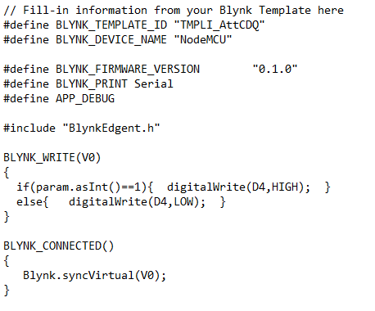
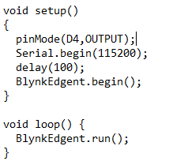
Code

Slide 16
Code
first in the code we have written template id and device name to connect our NodeMCU to the created blynk template by us.
then we have included blynk library for using the method requires to handle nodemcu using blynk dashboard.
Here V0 is nothing but datastream which we have created which is virtual pin
BLYNK_CONNECTED() { Blynk.syncVirtual(V0); } this line of code connects virtual pin that is datastream in the code.
BLYNK_WRITE(V0) {
if(param.asInt()==1){ digitalWrite(D4,HIGH); }
else{ digitalWrite(D4,LOW); } }
This is the logic written to make digital pin high or low depending on the virtual oin that is datasteram.

Slide 17
Conclusion
The home automation system has been experimentally proven to work satisfactorily by connecting sample appliances to it and the appliances were successfully controlled from a wireless mobile device.
We learned many skills such as wiring the circuit and other tools that we use for this project and was able to work together as a team for this project, The WiFi client was successfully tested on a multitude of different mobile phones from different manufacturers, thus proving its portability and wide compatibility. Thus a low-cost home automation system was successfully designed, implemented and tested.

Slide 18
Referrences
Blynk cloud platform documentation – https://docs.blynk.io/en/
Arduino documentation – https://www.arduino.cc/
Instructables.com - https://www.instructables.com/

